Slide 1
English for
International
Communication

Slide 2
奠基篇 Unit 3
Part 2 應答問題

Slide 3
奠基篇 Unit 3
題型說明
此部分共 25 題（測驗中 Q7-Q31），是四個聽力單元中唯一純粹考「聽」的能力之單元，問題及選項皆「不」出現在試題本中。每個問題有三個選項，作答者要試著選出最適當的回應。這個大題的題型及回答有一定的規則，只要充分了解並學會辨識關鍵字詞，便可輕鬆掌握得分。

Slide 4
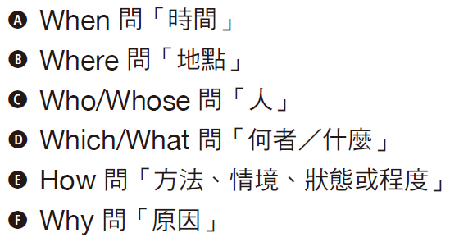
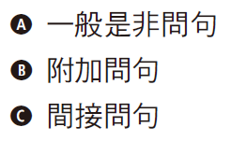
奠基篇 Unit 3
題型分析
題型1 | Wh- Questions 疑問詞疑問句 出題頻率：50％
題型2 | Yes/No Questions 是非問句 出題頻率：30％

Slide 5
奠基篇 Unit 3
題型3 | A or B Questions 選擇疑問句 出題頻率：10％ | 辨識方法： • 句中有關鍵連接詞or • 問句語調不上揚
題型4 | Statements 直述句 出題頻率：10％ | 辨識方法： • 整句無（助）動詞倒裝 • 句子語調不上揚

Slide 6
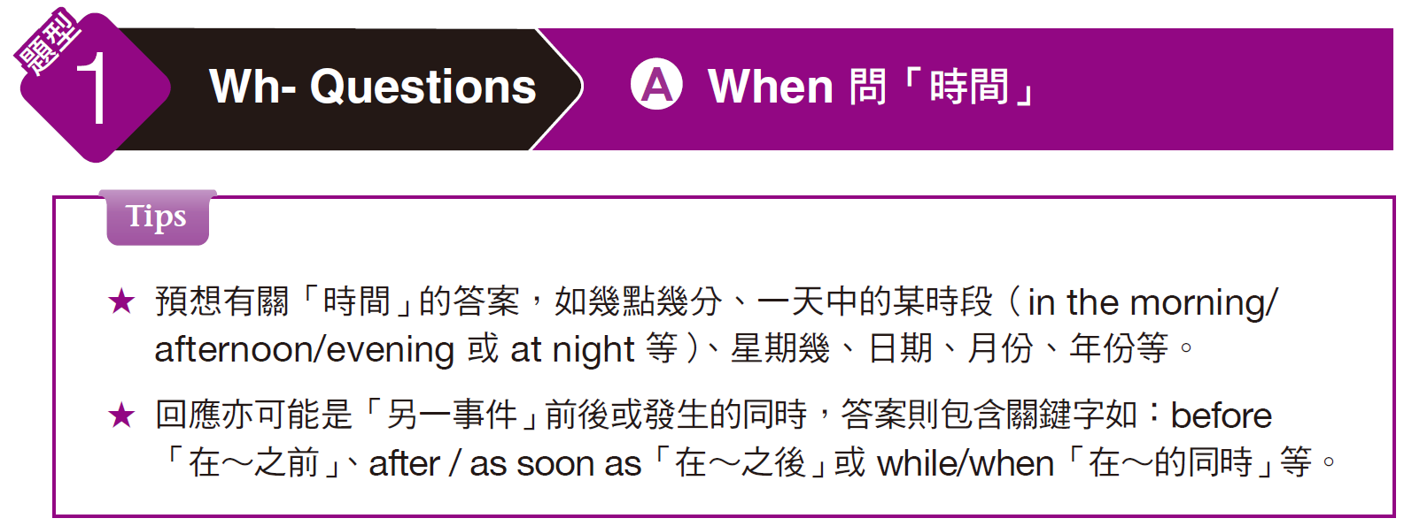
奠基篇 Unit 3

Slide 7

奠基篇 Unit 3
Examples
C
When do you want to hold the meeting?
(A) Let’s meet at the café.
(B) For about three days.
(C) Let’s schedule it for Tuesday.
_____ 1.
解析
題目問「你想要什麼時候舉行會議呢？」，解題關鍵字為表時間的 Tuesday，故適合的 選項為 (C)「讓我們預定在禮拜二吧。」
選項 (A) 是回答地點，選項 (B)「for + 一段時間」通常用來回應「花多長的時間」。

Slide 8
奠基篇 Unit 3
A
When did you become interested in computer programming?
(A) When I took a computer class at school.
(B) In about two or three weeks.
(C) I go online every day.
_____ 2.
解析
本題的意思為「你是什麼時候對電腦程式有興趣的？」，解題關鍵字為表時間的 When 「當～的時候」，故適合的選項為
(A)「當我在學校上電腦課的時候。」
選項 (B) 「in + 一段時間」表「在（多少時間）之後」，問句應為未來式，而非過去式。 選項 (C)「我每天都上網。」與時間無關。

Slide 9
奠基篇 Unit 3
Exercise
Listen to the audio track and select the best response to the question or statement.
A
______ 1.
When will the new books be delivered?
(A) They are due on Friday.
(B) I’ll finish them tomorrow.
(C) They’ll be brought by truck.
新書什麼時候會寄出？
(A) 它們星期五會送到。
(B) 我明天就會做完。
(C) 它們會透過卡車運送。

Slide 10
奠基篇 Unit 3
A
______ 2.
When will you have time to talk about the contract?
(A) I should have some free time
tomorrow.
(B) No, I don’t have any time off during the
holidays.
(C) Yes, the proposal looks very good.
你什麼時候有空來談一下合約？
(A) 我明天應該有空。
(B) 不，放假期間我都得上班。
(C) 對，這項提案看起來很不錯。

Slide 11
奠基篇 Unit 3
C
______ 3.
When do we have to turn in our applications for the computer course?
(A) The power switch is on the back.
(B) I think we’ll learn lots of applications.
(C) They’re due two weeks from Friday.
我們該什麼時候遞交電腦課的申請書？
(A) 電源開關在後面。
(B) 我想我們會學到很多應用程式。
(C) 從這星期五開始算，兩個星期內要交。

Slide 12
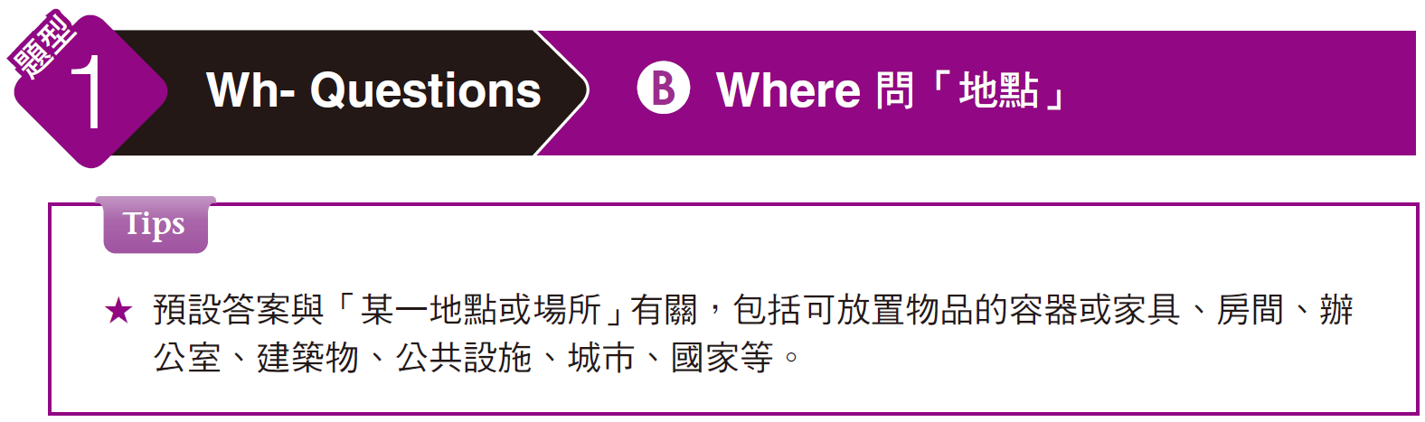
奠基篇 Unit 3

Slide 13
奠基篇 Unit 3
Examples
B
_____ 1.
Where is everyone going to go for lunch today?
(A) Most of us will be going about 12 noon.
(B) I think we’re all going to that new Italian restaurant.
(C) It will cost about 10 bucks for each.
解析
題目問「今天大家要去哪裡吃午餐呢？」，解題關鍵字為表地點的 restaurant，故適合的選項為 (B)「我想我們應該都會去那間新的義大利餐廳吧。」
選項 (A)「我們大多數人會大約在中午十二點去。」為回應時間。選項 (C)「每個人要花費大約十美元。」為回應費用多少，(A)、(C)皆與地點無關。

Slide 14
奠基篇 Unit 3
A
_____ 2.
Where should we put all of the reports?
(A) We can store them in this drawer.
(B) Now would be a good time to report.
(C) Patrick will call when he is finished.
解析
本題問「我們應該把這些報告放在哪裡呢？」，解題關鍵字為表地點的 drawer，故適合的選項為 (A)「我們可以把它們存放在這個抽屜裡。」
選項(B)「現在會是報告的好時間。」和選項(C)「當派翠克完成時他會打電話來。」皆與地點無關。

Slide 15
奠基篇 Unit 3
Exercise
Listen to the audio track and select the best response to the question or statement.
A
______ 1.
Where should I put my jacket?
(A) On the chair is fine.
(B) That’s a nice jacket.
(C) Where are you going?
我該把外套放在哪？
(A) 放在椅子上就可以了。
(B) 那件外套真不錯。
(C) 你要去哪裡？

Slide 16
奠基篇 Unit 3
B
______ 2.
Where are you off to?
(A) I turned off the TV.
(B) I’m on my way to the office.
(C) I’ll be fine.
你要去哪裡？
(A) 我把電視關掉了。
(B) 我正要去辦公室。
(C) 我會好起來的。

Slide 17
奠基篇 Unit 3
B
______ 3.
Where do we store sales brochures from previous
years?
(A) This year’s brochures are filed under C for current.
(B) There are electronic versions on these CDs.
(C) You can buy some at the stationery store next door.
我們把前幾年的產品介紹手冊放在哪裡？
(A) 今年的手冊都歸檔在代表「現行」的字母C下。
(B) 這些光碟裡有電子版的。
(C) 你可以到隔壁的文具店買。

Slide 18
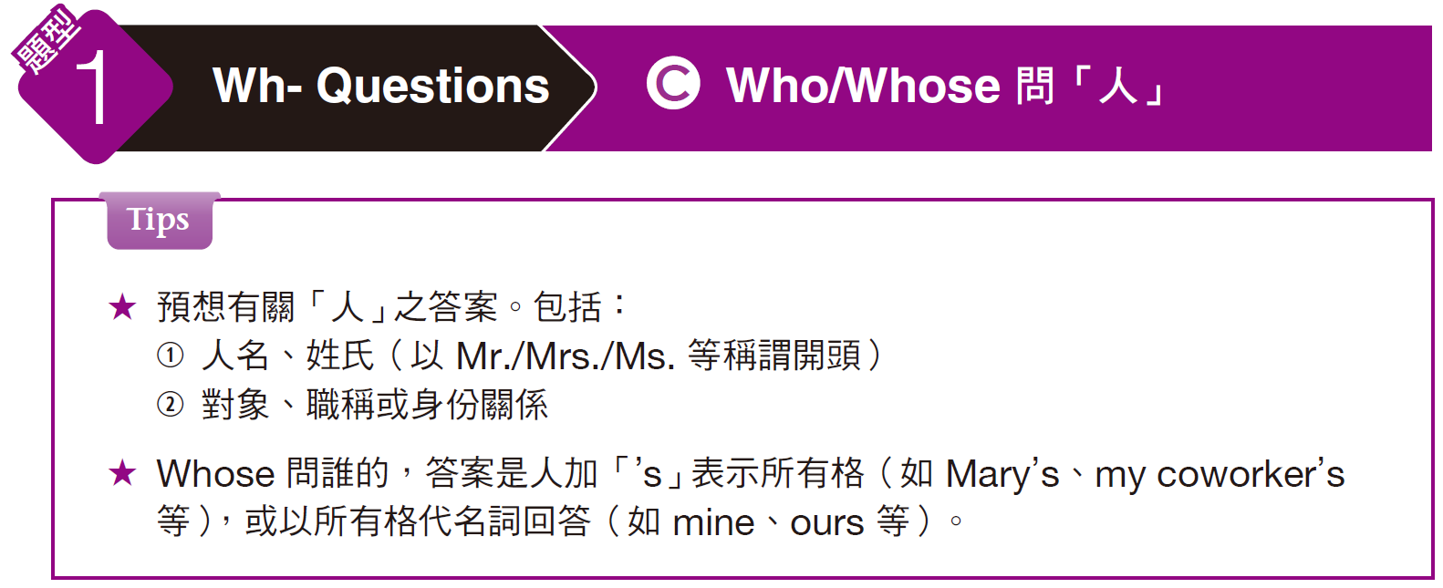
奠基篇 Unit 3

Slide 19
奠基篇 Unit 3
Examples
B
_____ 1.
Who do I give my application form to?
(A) That’s very kind of you.
(B) Give it to your manager.
(C) Turn it in tomorrow.
解析
application form 指「申請表」。題目問「我的申請表應該交給誰呢？」，解題關鍵字為表人物職稱的 manager，故適合的選項為(B)「交給你的主管。」
選項 (A)「你人真好。」與題目不符。選項 (C)「明天呈交。」乃回應時間。

Slide 20
奠基篇 Unit 3
C
Whose turn is it to pay for lunch today, yours or mine?
(A) I get to choose what we eat.
(B) I turned at the last light.
(C) Neither. It’s Peter’s turn.
_____ 2.
解析
題目 Whose turn . . . 是問「輪到誰……」，turn 在此作名詞，指「（依次輪流時的）一次機會」，整句是問「輪到誰付今天的午餐，是你還是我呢？」，解題關鍵字為表人物所有格的 Peter’s，故適合答案為 (C)「都不是。是輪到彼得了。」
選項 (A)「我得選擇我們要吃什麼。」與題目要問的「人」無關。選項 (B)「我在上一個燈號轉彎（turn）了。」乃利用同音異義字混淆作答。

Slide 21
奠基篇 Unit 3
Exercise
Listen to the audio track and select the best response to the question or statement.
B
______ 1.
Who’s going to take the blame for losing the advertising file?
(A) My sister works next door.
(B) It was my responsibility.
(C) I don’t think we need to advertise.
誰該為弄丟廣告文件負責？
(A) 我姊姊在隔壁工作。
(B) 我該負責。
(C) 我不認為我們需要打廣告。

Slide 22
奠基篇 Unit 3
B
______ 2.
Whose desk should I put these papers on?
(A) Maybe you shouldn’t.
(B) Put them on mine.
(C) This is the smaller desk.
我應該把這些文件放在誰的桌子上？
(A) 也許你不應該這樣做。
(B) 放在我桌上。
(C) 這是比較小的桌子。

Slide 23
奠基篇 Unit 3
B
Excuse me, who’s that woman over there with the blue coat?
(A) Yes, it is hers.
(B) Oh, that’s my colleague Betty.
(C) The blue coat over there is mine.
______ 3.
請問一下，那邊那位穿著藍色外套的女人是誰？
(A) 對，這是她的。
(B) 噢，那是我的同事貝蒂。
(C) 那邊那件藍色外套是我的。

Slide 24
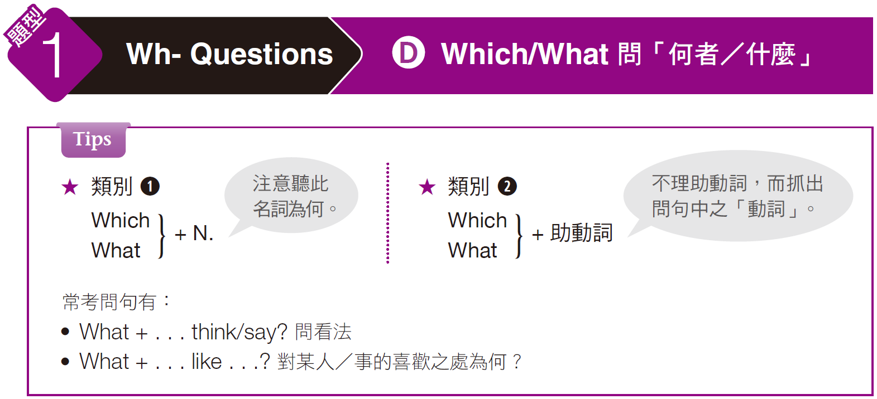
奠基篇 Unit 3

Slide 25
奠基篇 Unit 3
Examples
A
_____ 1.
Which bills still need to be paid?
(A) Just the water bill, I think.
(B) Bill will pay them.
(C) Thanks for all your help.
解析
此題屬上述的類別 1，要注意題目中的名詞為何。題目是問「還有哪些帳單要付？」，適合答案為 (A)「我想只有水費帳單了。」
選項 (B)「比爾會付它們。」，用同音字的人名 Bill來混淆作答。選項 (C)「謝謝你幫的所有忙。」與題目無關。

Slide 26
奠基篇 Unit 3
B
_____ 2.
What do you think about TV advertising?
(A) I think of you a lot.
(B) I don’t think we have that kind of budget.
(C) I didn’t watch any TV.
解析
名詞 advertising 指「（總稱）廣告」。本句是問「你對電視廣告有什麼看法？」，相關的回答是 (B)「我不認為我們有那樣的預算。」
選項 (A)「我常想到你。」和選項 (C)「我都沒有看電視。」的回答皆與題目無關。

Slide 27
奠基篇 Unit 3
Exercise
Listen to the audio track and select the best response to the question or statement.
C
______ 1.
What do you mean you have to cancel our
date?
(A) I’m sorry. I’ll bring it tomorrow.
(B) My brother wants a hot dog, not fruit.
(C) I can’t go. I have to look after my cousin.
你說要取消我們的約會是什麼意思？
(A) 對不起，我明天會把它帶過來。
(B) 我哥哥想要熱狗，不是水果。
(C) 我沒辦法赴約，我得照顧我表弟。

Slide 28
奠基篇 Unit 3
A
______ 2.
Which table would you like to sit at?
(A) Let’s get one by the window.
(B) I think I want Japanese food.
(C) No, I don’t like this kind.
你想坐在哪裡？
(A) 我們坐窗邊的位子好了。
(B) 我想要吃日本料理。
(C) 不，我不喜歡這一種。

Slide 29
奠基篇 Unit 3
A
______ 3.
What makes you think she will change her
mind?
(A) The proposal is just too good to turn down.
(B) She doesn’t change her mind very often.
(C) Five o’clock should be fine, if you ask me.
是什麼讓你覺得她會改變心意？
(A) 這份提案好到她無法拒絕。
(B) 她不常改變心意。
(C) 如果你問我的話，五點應該可以。

Slide 30
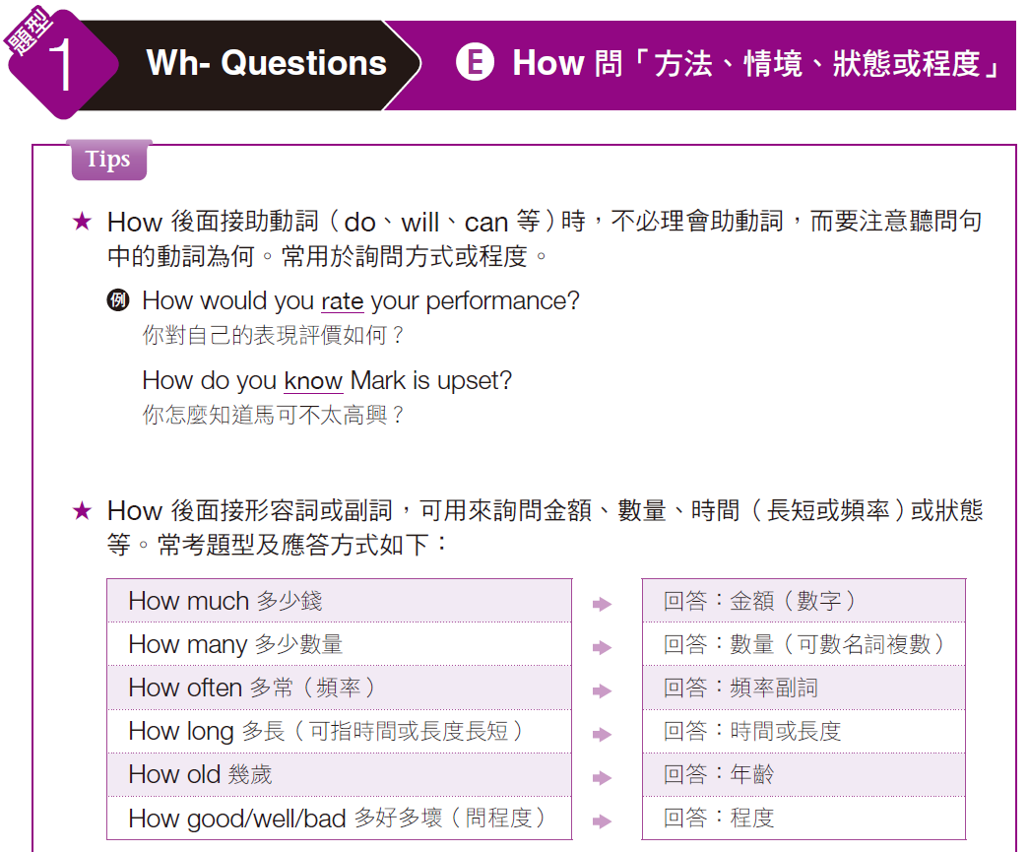
奠基篇 Unit 3

Slide 31
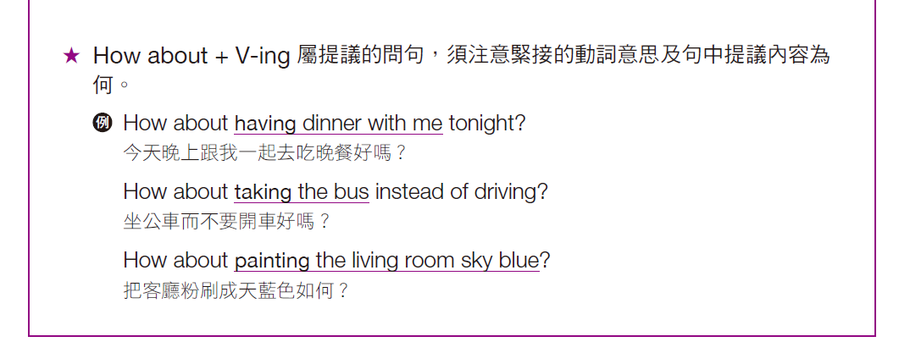
奠基篇 Unit 3

Slide 32
奠基篇 Unit 3
Examples
C
_____ 1.
How do I turn down the air conditioner?
(A) The repair shop is on the corner.
(B) The system is down until tomorrow.
(C) Watch me. I’ll show you.
解析
「How＋助動詞」句型要注意動詞為何。動詞片語 turn down 有「將電器強度調弱、聲音調小」及「拒絕」等意，問句意思是「我要如何將空調調弱？」，故適合答案為 (C)「看著我，我做給你看。」
選項 (A)「維修店就在轉角。」乃回答地點。選項 (B)「系統到明天之前都是壞的。」，這裡的 down 為形容詞，指「壞的；不在運作的」，乃利用同音字混淆作答。

Slide 33
奠基篇 Unit 3
A
_____ 2.
How long do you need to borrow the car for tomorrow?
(A) Oh, just a couple of hours.
(B) It has been a long time since I drove.
(C) Yes, I’ll be coming along, too.
解析
句型 How long . . . 是問時間或長度長短。題目意思是「你明天借車要用多久？」最適合選項為 (A)「喔，只需要幾個小時。」
選項 (B)「從我開車到現在已經很久了。」與題目不符。(C) 乃利用題目中 long 的近音字 along 來混淆作答，come along 為「一起來」之意，整句意思是「是啊，我也會一起來。」

Slide 34
奠基篇 Unit 3
C
_____ 3.
How about advertising on the radio and TV?
(A) Has the television station called?
(B) The television is in the lobby, next to the radio.
(C) I think that would be very effective.
解析
聽到題目中的 How about 便知道要注意其後的動詞及提議內容。動詞 advertise 指「為……做廣告；為……宣傳」。問題意思為「在廣播和電視上播廣告如何？」，與主題相關的回應為 (C) I think that would be very effective.「我想那會很有效果。」
選項 (A)「電視台打電話來了嗎？」與題目不符。選項 (B)「電視在大廳，就在收音機旁邊。」乃回應地點。

Slide 35
奠基篇 Unit 3
Exercise
Listen to the audio track and select the best response to the question or statement.
C
______ 1.
How much did you pay for your car?
(A) I looked for months before I found one I liked.
(B) I drove it about 450 miles.
(C) It was about US$22,000.
你買這輛車花了多少錢？
(A) 我看了好幾個月才找到我喜歡的。
(B) 我開了大約四百五十英里。
(C) 大約兩萬二美元。

Slide 36
奠基篇 Unit 3
B
______ 2.
How are you going to persuade Cindy to go out to lunch with you?
(A) I know a few nice places.
(B) I’ll tell her it’s my treat.
(C) To go, please.
你要如何說服辛蒂跟你一起出去吃午餐呢？
(A) 我知道幾個不錯的地方。
(B) 我會跟她說我請客。
(C) 我要外帶，謝謝。

Slide 37
奠基篇 Unit 3
B
How high should I hang this picture?
(A) It is 12 inches high.
(B) Put it at eye level.
(C) Use the ladder to hang it.
______ 3.
我應該把這幅畫掛得多高？
(A) 這有十二吋高。
(B) 大約眼睛的高度。
(C) 踩在梯子上掛。

Slide 38
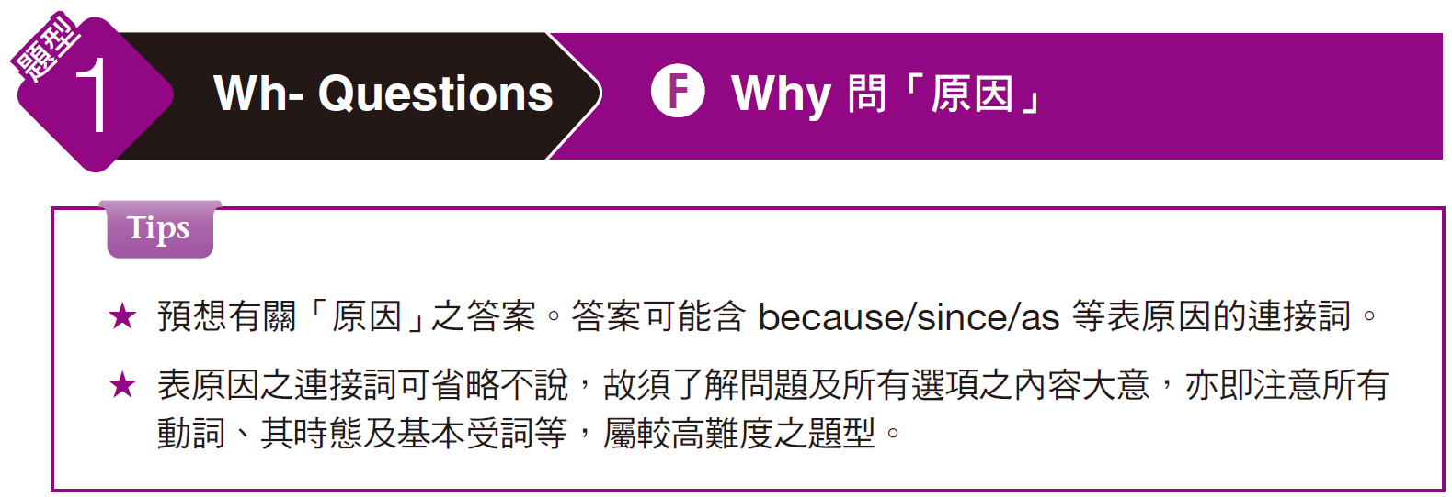
奠基篇 Unit 3

Slide 39
奠基篇 Unit 3
Examples
B
_____ 1.
Why are we having a meeting on Saturday?
(A) The conference will take too much time.
(B) We have to finalize plans before Monday.
(C) Because my flight was delayed.
解析
這句是問「我們為什麼要在星期六開會？」，切合題意的回應為 (B)「我們必須在星期一之前將計畫定案。」
選項 (A)「會議將會花費太多時間。」與題目不符。選項 (C) 的 Because 可用來回應原因，但整句「因為我的班機延誤了。」意思與過去式時態皆與題目不符。

Slide 40
奠基篇 Unit 3
C
Why haven’t you had your car repaired yet?
(A) Yes, I did it twice last week.
(B) It would be a great help if you could.
(C) It is going to be very expensive.
_____ 2.
解析
本題的意思為「你為什麼還沒修理你的車呢？」，適合的選項為
(C)「那一定會很貴。」
選項 (A)「是的，我上星期修了兩次。」與選項 (B)「如果你可以那就會是幫了大忙。」皆與題目不符。

Slide 41
奠基篇 Unit 3
Exercise
Listen to the audio track and select the best response to the question or statement.
C
Hey Josh, why are you still in the office?
(A) I need to pick up some groceries.
(B) I was late for work.
(C) I have a few things I need to finish.
______ 1.
嘿，賈許，你怎麼還待在辦公室？
(A) 我得買些雜貨。
(B) 我上班遲到了。
(C) 我還有幾項工作要完成。

Slide 42
奠基篇 Unit 3
B
______ 2.
Why do I always get caught in traffic?
(A) Did you take a wrong turn?
(B) You leave too late in the morning.
(C) Yes, there weren’t many cars this morning.
為什麼我每次都塞在車陣中呢？
(A) 你是不是轉錯彎了？
(B) 你早上太晚出門了。
(C) 對，今天早上沒有很多車。

Slide 43
奠基篇 Unit 3
A
______ 3.
Why is this computer not working?
(A) Have you turned it on?
(B) Maybe we should take a break.
(C) Work is quite difficult.
這台電腦為什麼不能用？
(A) 你打開它了嗎？
(B) 也許我們該休息一下。
(C) 工作是件挺困難的事。

Slide 44
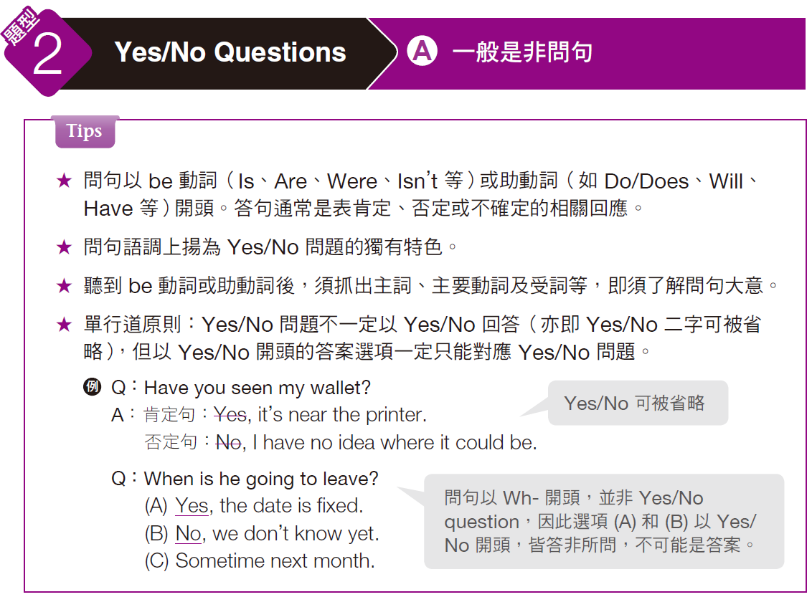
奠基篇 Unit 3

Slide 45
奠基篇 Unit 3
Example
A
Did you hear the big news about our boss?
(A) No, what happened?
(B) I plan to later.
(C) Turn on the radio.
_____ 1.
解析
本題先抓出主詞（you）、主要動詞（hear）及受詞（the big news about our boss），即問「你有聽到這個關於我們老闆的大消息嗎？」，適合的選項為 (A)「沒有，發生了什麼事情嗎？」
選項 (B) 「我打算等一下去做。」為回應時間。選項 (C)「打開收音機。」與問題無關。

Slide 46
奠基篇 Unit 3
Exercise
Listen to the audio track and select the best response to the question or statement.
C
______ 1.
Did you make the airline reservations for our trip yet? reserve (V.)
(A) Sure, anytime.
(B) Great, I want to go, too.
(C) Sure. I booked them online.
你訂了我們這次旅行的機票了嗎？
(A) 不客氣。
(B) 太好了，我也想去。
(C) 當然，我在網路上訂的。

Slide 47
奠基篇 Unit 3
A
______ 2.
Is it time to begin the speeches yet?
(A) We should wait for an hour.
(B) We will speak until eight o’clock.
(C) Next week would be a good time.
演講要開始了嗎？
(A) 我們應該要等一個小時。
(B) 我們會講到八點。
(C) 下星期應該可以。

Slide 48
奠基篇 Unit 3
B
______ 3.
Have you finished making all of the phone calls yet?
(A) No one has called me yet.
(B) No, I still have about 10 to make.
(C) The best phone to use is over there.
你把這些電話都打完了嗎？
(A) 還沒有人打給我。
(B) 不，我還有大約十通電話要打。
(C) 最好用的電話在那裡。

Slide 49
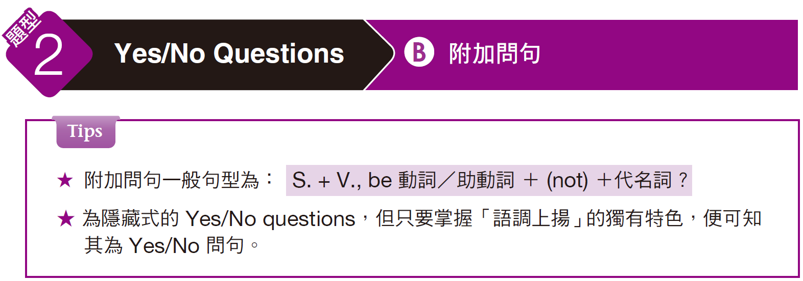
奠基篇 Unit 3

Slide 50
奠基篇 Unit 3
Examples
B
_____ 1.
You will be coming in to the office on Saturday, won’t you?
(A) Sure, I will go to your party on Saturday.
(B) Yes, I have some things to finish up.
(C) I’ll be arriving in ten more minutes.
解析
本題為附加問句題型。意思為「你星期六要來辦公室，對吧？」，適合的選項為 (B)「對啊，我有些事情要處理完。」
選項 (A) 「當然，我星期六會去你的派對。」和選項 (C) 「我再十分鐘就會到。」皆與題意不符。

Slide 51
奠基篇 Unit 3
B
_____ 2.
You did back up the computer hard drive, didn’t you?
(A) Yes, it’s mine.
(B) I did it yesterday.
(C) Right, on the back.
解析
本題的意思是「你有將電腦硬碟做備份了，對吧？」適合的選項為 (B)「我昨天有備份了。」
選項 (A)「對啊，那是我的。」與題意不符。選項 (C)「對，在後面。」乃回應地點，且利用同音異義字 back「後面」與題目中的動詞片語 back up 混淆作答。

Slide 52
奠基篇 Unit 3
Exercise
Listen to the audio track and select the best response to the question or statement.
B
______ 1.
You did tell our manager we wouldn’t be there, didn’t you?
(A) Yes, I didn’t.
(B) Sure, I did.
(C) Yes, you did.
你有告訴經理我們不會去，對吧？
(A) 對，我沒說。
(B) 當然，我說了。
(C) 對，你說了。

Slide 53
奠基篇 Unit 3
I guess we will see each other at the conference next month, won’t we?
(A) Yes, I’m really looking forward to that.
(B) Yes, the weather doesn’t look good.
(C) I hate conference calls.
A
______ 2.
look forward to + Ving/ N. = expect
She was looking forward to seeing the grandchildren again.
I'm really looking forward to my holiday.

Slide 54
奠基篇 Unit 3
B
______ 3.
You bought a new suit, didn’t you?
(A) I bought it at the department store.
(B) You noticed! I had it made last week.
(C) No, it didn’t fit very well.
你買了新西裝，對吧？
(A) 我在百貨公司買的。
(B) 你注意到了！我上星期才去訂做的。
(C) 不，這件不太合身。

Slide 55
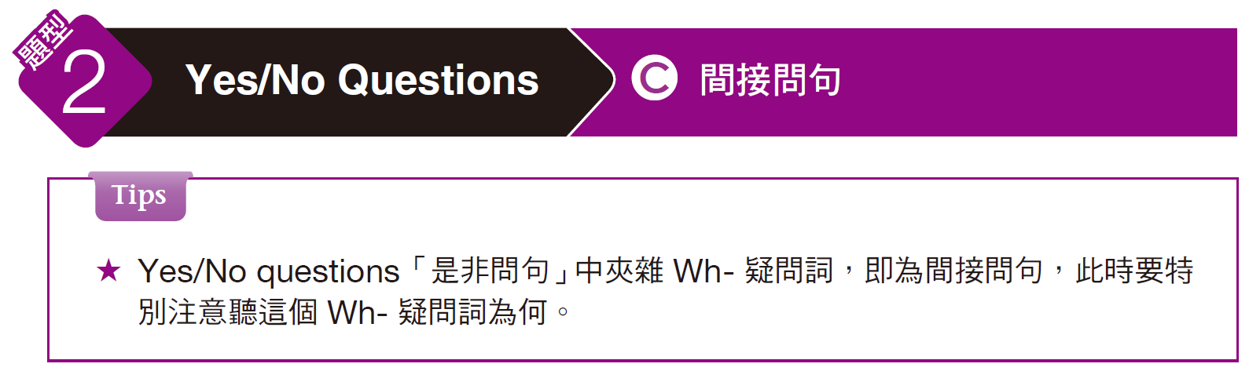
奠基篇 Unit 3

Slide 56
奠基篇 Unit 3
Examples
B
Do you have any idea what time the movie starts?
(A) It stars Julia Roberts.
(B) I think it starts at three.
(C) It’s a two-hour movie.
_____ 1.
解析
問句以助動詞 Do 開頭，推斷為是非問句，中間又聽到what time，得知為間接問句且要選擇跟時間有關的選項。題目問「你知道電影什麼時候開始嗎？」，適合的選項為 (B)「我想是三點開始。」
選項 (A)「由茱莉亞‧羅勃茲主演。」為回應「人」。選項 (C)「那是兩個小時的電影。」則回應時間多長。

Slide 57
奠基篇 Unit 3
A
Can you tell me how long the table is?
(A) It is six feet by three feet.
(B) She’s been waiting for an hour.
(C) It’ll be ready at six.
_____ 2.
解析
本題為間接問句，故要注意聽中間的疑問詞 how long，題目的意思為「你可以告訴我這個桌子有多長嗎？」，相關的回答為 (A)「六英尺長，三英尺寬。」
選項 (B)「她等了一個小時。」為回應時間多久。選項 (C)「六點時會準備好。」乃回應何時。

Slide 58
奠基篇 Unit 3
Exercise
Listen to the audio track and select the best response to the question or statement.
C
______ 1.
Can I ask why you are moving to California?
(A) No, I haven’t found a house yet.
(B) It’s going to cost a lot.
(C) I’ve got a new job there.
我可以問為什麼你要搬去加州嗎？
(A) 不，我還沒找到房子。
(B) 這一定要花很多錢。
(C) 我在那邊有新工作了。

Slide 59
奠基篇 Unit 3
B
Do you know when the manager will be back?
(A) Yes, she will.
(B) Sorry, I don’t.
(C) Yes, it’s Wendy.
______ 2.
你知道經理什麼時候會回來嗎？
(A) 對，她會。
(B) 抱歉，我不知道。
(C) 對，是溫蒂。

Slide 60
奠基篇 Unit 3
A
______ 3.
Can you tell me which desk I should sit at?
(A) Sure, you can sit right here.
(B) Yes, there are plenty of seats.
(C) Which one is it?
你能告訴我該坐哪一桌嗎？
(A) 當然，你可以坐在這。
(B) 對，有很多座位。
(C) 是哪一個？

Slide 61
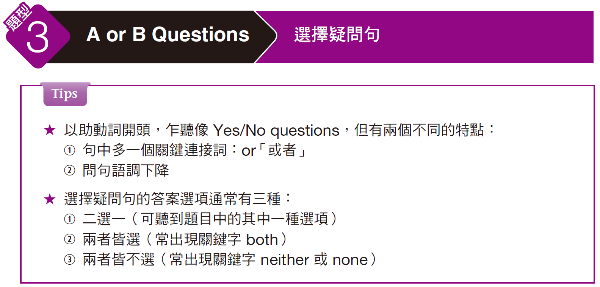
奠基篇 Unit 3

Slide 62
奠基篇 Unit 3
Examples
C
Does your manager arrive tomorrow or the next day?
(A) I’ll call her tomorrow.
(B) She is in town for two days.
(C) She gets into town tomorrow.
_____ 1.
解析
本題以助動詞開頭但又多了一個關鍵字 or，得知為「選擇疑問句」題型。題目問「你的經理會明天抵達還是隔一天呢？」，適合的選項為 (C)「她明天就會到城裡了。」
選項 (A)「我明天會打電話給她。」和選項 (B)「她會在城裡待兩天。」皆與題意不符。

Slide 63
奠基篇 Unit 3
C
Do you want to work the morning shift or the evening shift tomorrow?
(A) Yes, it’s tomorrow morning.
(B) Let me shift to next week.
(C) I’d prefer the earlier shift.
_____ 2.
解析
本題為「選擇疑問句」題型。題目中的 shift 為名詞，指「輪班；輪班工作時間」。整句意思是「你明天想要上早班還是晚班呢？」，適合的選項為 (C)「我比較喜歡早一點的班。」
聽到問句中有 or，並非 Yes/No questions，故出現 Yes 的選項 (A) 不會是正確答案。選項 (B) 中的 shift 為動詞，指「變換；改變」，這句說「讓我換到下星期。」答非所問。

Slide 64
奠基篇 Unit 3
Exercise
Listen to the audio track and select the best response to the question or statement.
B
______ 1.
Would you like to fly first class or economy?
(A) Right, my first class is economics.
(B) What is the price difference?
(C) I think it will improve soon.
您想要坐頭等艙還是經濟艙？
(A) 對，我的第一堂課是經濟學。
(B) 價格有什麼不同？
(C) 我想這很快就會改善。

Slide 65
奠基篇 Unit 3
B
______ 2.
Excuse me, is this folder yours or mine?
(A) I haven’t seen it.
(B) I think it’s yours.
(C) Yes, it’s hers.
請問一下，這個文件夾是你的還是我的？
(A) 我沒看到它。
(B) 我想應該是你的。
(C) 對，是她的。

Slide 66
奠基篇 Unit 3
B
______ 3.
Do you prefer the black jacket or the gray one?
(A) Yes, that’s my jacket.
(B) Neither. I don’t like dark colors.
(C) I like Jack very much.
你比較喜歡黑色的夾克還是灰色的？
(A) 對，那是我的夾克。
(B) 兩個都不喜歡，我不喜歡暗色系的。
(C) 我非常喜歡傑克

Slide 67
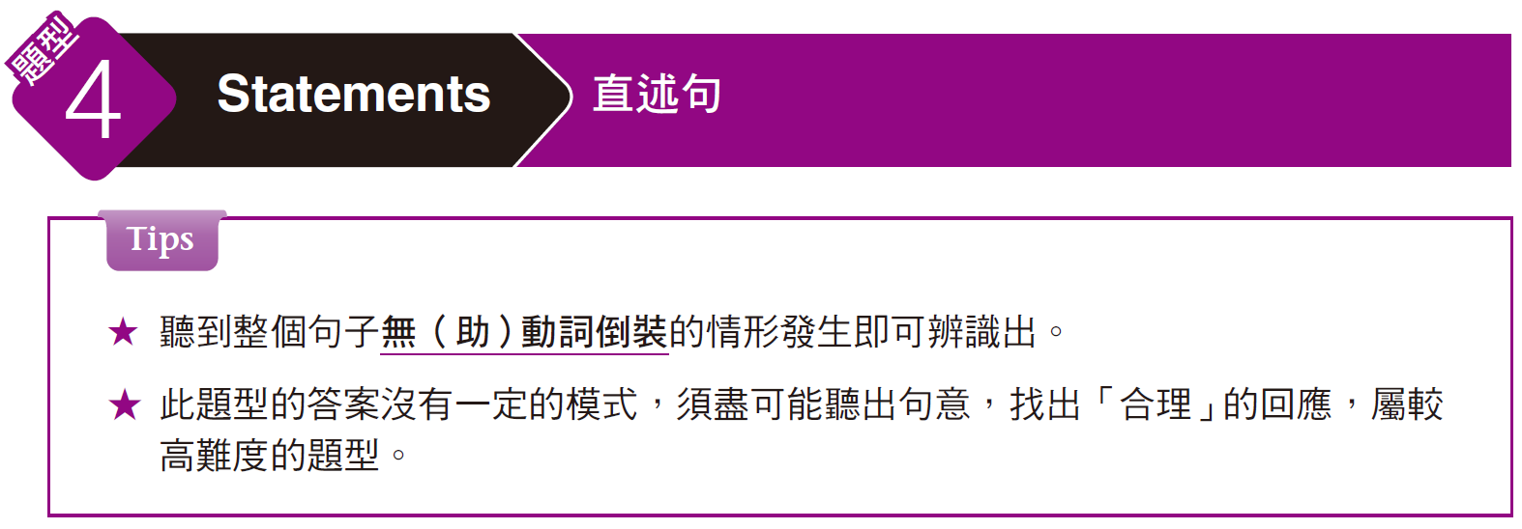
奠基篇 Unit 3

Slide 68
奠基篇 Unit 3
Examples
A
_____ 1.
The training was very helpful; I learned a lot.
(A) I’m glad it was useful.
(B) No, you didn’t help much.
(C) Taking the train is better.
解析
本題的意思為「這個訓練很有幫助，我從中學到很多。」，適合的選項為 (A)「我很高興它是有用的。」
選項 (B)「不，你沒有幫很多忙。」與選項 (C)「搭火車會比較好。」皆與題目不符。選項中刻意用 help 和train 字眼企圖與題目中的 helpful 和 training 造成混淆。

Slide 69
奠基篇 Unit 3
C
_____ 2.
Hey, I thought your presentation was impressive.
(A) It will begin soon.
(B) No, it was yesterday.
(C) You did? Thank you.
解析
本題的意思為「嘿，我覺得你的報告非常讓人印象深刻。」，適合的選項為 (C)「你真的這麼認為嗎？謝謝你。」
選項 (A)「很快就會開始了。」與選項 (B)「不，那是在昨天。」皆與題意不符。

Slide 70
奠基篇 Unit 3
Exercise
Listen to the audio track and select the best response to the question or statement.
B
______ 1.
I need to know when and where to meet you on Saturday.
(A) It’ll cost more if we meet them now.
(B) Let’s meet at noon at the train station.
(C) Paul will be downtown at the office.
我需要知道星期六和你約的時間和地點。
(A) 如果我們現在和他們碰面的話會花更多錢。
(B) 我們約中午在火車站碰面吧。
(C) 保羅會在市中心的辦公室。

Slide 71
奠基篇 Unit 3
A
Please show me how to use the coffee machine.
(A) OK. First, clean the pot.
(B) It’s in the kitchen.
(C) Not for me, thanks.
______ 2.
請告訴我如何使用這台咖啡機。
(A) 沒問題。首先，先清洗水壺。
(B) 在廚房。
(C) 我不需要，謝謝。

Slide 72
奠基篇 Unit 3
B
I really need a bigger desk with so much work to do.
(A) You can help me now.
(B) You do have a lot of work.
(C) How soon will you be here?
______ 3.
我真的需要一張更大的桌子來處理這麼多工作。
(A) 你現在可以幫我。
(B) 你真的有很多工作。
(C) 你會多快到達這裡？

Slide 73
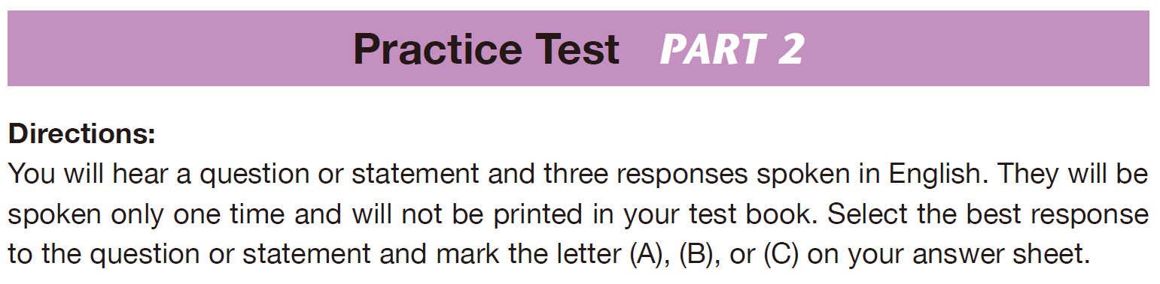
奠基篇 Unit 3

Slide 74
奠基篇 Unit 3
A
_____ 1.
  Why are you dressed so warm?
  (A) I’m freezing!
  (B) Yes, it is cold.
  (C) No, I’m not hot.
  你為什麼穿得這麼暖？
  (A) 我覺得好冷！
  (B) 對，真的很冷。
  (C) 不，我不熱。
B
_____ 2.
  I hope I get the promotion to manager; I really want the job.
  (A) Yes, you were lucky.
  (B) Well, good luck.
  (C) It costs a fortune.
  我希望我可以升經理；我真的很想要這份工作。
  (A) 對，你很幸運。
  (B) 那麼，祝你好運囉。
  (C) 這所費不貲。

Slide 75
奠基篇 Unit 3
B
_____ 3.
  Will you be free for half an hour later this afternoon?
  (A) No, it’ll cost more than that.
  (B) Yes. What time do you want to meet?
  (C) No, I’m not feeling all that well. Thanks.
  你今天下午能撥出半小時的空檔嗎？
  (A) 不，這會花更多錢。
  (B) 可以。你想要什麼時候碰面？
  (C) 不，我不是很舒服。謝了。
C
_____ 4.
Whose report is this? There’s no name on the cover.
(A) I’m not sure what its name is.
(B) I don’t think so, either.
(C) Maybe the name’s inside.
這是誰的報告書？封面上沒有寫名字。
(A) 我不確定它的名字是什麼。
(B) 我也不這麼認為。
(C) 也許名字寫在裡面。

Slide 76
奠基篇 Unit 3
B
_____ 5.
Which necktie looks better with this coat, the blue one or the red one?
(A) The blue one fits very well.
(B) The red one matches it better.
(C) Both will cost a lot.
哪一條領帶配上這件外套比較好看？藍色的還是紅色的？
(A) 藍色的非常合身。
(B) 紅色的配起來比較好看。
(C) 兩條都會花很多錢。
A
_____ 6.
Could you lend me your calculator for a minute?
(A) Certainly. Anytime.
(B) Oh, thanks. I need it.
(C) Here, it’s open to January.
可以借我一下你的計算機嗎？
(A) 當然，隨時都可以。
(B) 噢，謝謝，我很需要。
(C) 就是這，開到一月。

Slide 77
奠基篇 Unit 3
B
_____ 7.
Where do I turn in my completed time card each month?
(A) Turn it toward the window.
(B) Give it to the HR department.
(C) Fill this out.
每個月完整的考勤卡應該交到哪裡？
(A) 把它轉向窗戶。
(B) 交給人資部門。
(C) 將這個填好。
B
_____ 8.
Can I offer you a ride home this afternoon?
(A) Yeah, let’s ride the bus home.
(B) No, thanks. My sister’s picking me up.
(C) I haven’t written home yet.
我下午可以載你回家嗎？
(A) 好啊，我們搭公車回家吧。
(B) 不，謝了，我姊姊會來接我。
(C) 我還沒寫信回家。

Slide 78
奠基篇 Unit 3
C
_____ 9.
Are they going to hold the event at their office or at a hotel meeting room?
(A) No, they haven’t scheduled the event yet.
(B) Yes, we’ll be meeting with the hotel staff soon.
(C) Probably at a hotel where there is more space.
他們打算把活動辦在他們的辦公室還是飯店的會議室？
(A) 不，他們還未計畫活動。
(B) 是的，我們很快就會和飯店人員會面。
(C) 很可能會辦在場地比較大的飯店。
B
_____ 10.
Can you show me how to get started with this software?
(A) The show starts at six.
(B) Sure, I’ll help you out.
(C) Sure, click here to exit.
你可以告訴我該怎麼啟動這個軟體嗎？
(A) 表演六點開始。
(B) 當然，我可以幫你。
(C) 當然，按這裡退出。

Slide 79
奠基篇 Unit 3
A
_____ 11.
_____ 12.
This is the best coffee I’ve ever tasted!
(A) It sure does taste fresh, doesn’t it?
(B) No, thanks, I don’t drink coffee.
(C) It does taste like coffee, doesn’t it?
這是我喝過最棒的咖啡了！
(A) 喝起來真的很新鮮，對吧。
(B) 不，謝了，我不喝咖啡。
(C) 這喝起來真像咖啡，對吧。
A
Which table would you like, that one by the window or this one?
(A) That one. I think it has a better view.
(B) Which is more expensive?
(C) I want the window, not the table.
你想要坐哪裡？靠窗的那個位子還是這裡？
(A) 那個位子，我認為那裡視野比較好。
(B) 哪一個比較貴？
(C) 我想要窗戶，不是桌子。

Slide 80
奠基篇 Unit 3
A
_____ 13.
_____ 14.
Are you going to fly to Los Angeles or drive?
(A) It’ll be faster to take a plane.
(B) Yes, I’ll get there very quickly.
(C) Yes, I am going to Los Angeles tomorrow.
你打算坐飛機去洛杉磯還是開車？
(A) 坐飛機比較快。
(B) 對，我很快就會抵達。
(C) 對，我明天要去洛杉磯。
A
Do you think this book is worth reading?
(A) Yes, you should read it.
(B) No, that’s a little expensive.
(C) Yes, it costs seven dollars and fifty cents.
你認為這本書值得一讀嗎？
(A) 對，你應該讀這本書。
(B) 不，那有點貴。
(C) 對，這要七塊五十分錢。

Slide 81
奠基篇 Unit 3
A
_____ 15.
_____ 16.
Do you know where I can buy a new computer?
(A) Yes, try the shop down the street.
(B) Yes, I can do it for you tomorrow.
(C) Next week we’ll be finding one.
你知道哪裡可以買新電腦嗎？
(A) 我知道，可以去街上那間商店看看。
(B) 好，我明天可以幫你做。
(C) 下星期我們會找到一個。
C
I can’t imagine being as wealthy as she is!
(A) She is in pretty bad shape.
(B) I wouldn’t want to be either.
(C) She is rich, isn’t she?
我無法想像能夠像她一樣那麼有錢！
(A) 她的身材不是很好。
(B) 我也不想。
(C) 她很有錢，不是嗎？

Slide 82
奠基篇 Unit 3
B
_____ 17.
How much is a round-trip ticket to Hong Kong?
(A) It’s around there.
(B) I’ll check online for you.
(C) Yes, a round-trip ticket is best.
香港來回機票需要多少錢？
(A) 就在那附近。
(B) 我幫你上網查一下。
(C) 對，來回票是最好的。
A
_____ 18.
What will we do if we can’t find the restaurant?
(A) We’ll have to call for directions.
(B) We have to go directly there.
(C) Which direction do you want to drive in?
如果找不到餐廳的話該怎麼辦？
(A) 我們應該打電話詢問該怎麼走。
(B) 我們應該直接過去。
(C) 你想要從哪個方向開進去？

Slide 83
奠基篇 Unit 3
B
_____ 19.
_____ 20.
Which model of car are you interested in buying?
(A) We don’t like modeling.
(B) We’re hoping to buy a sedan.
(C) I want to buy it at the dealer next door.
你想買哪一型的車呢？
(A) 我們不喜歡做模特兒展示。
(B) 我們比較想要買一台轎車。
(C) 我想要在隔壁的經銷商購買。
A
We really need more help in our department.
(A) Yes, there’s too much to do.
(B) We have four people in the department.
(C) We don’t have a sales department.
我們部門真的非常需要幫忙。
(A) 對，有太多事情得做。
(B) 我們部門有四個人。
(C) 我們沒有營業部。

Slide 84
奠基篇 Unit 3
B
_____ 21.
_____ 22.
Is this the desk where I turn in my application form?
(A) It is near the door.
(B) Yes, set it here.
(C) No, I’ll take it.
要繳交的申請表是放在這張桌子上嗎？
(A) 就在門附近。
(B) 對，放在這裡。
(C) 不，我會拿走。
B
Do you want to go out for some lunch?
(A) Yes, I did.
(B) Good idea. Let’s go.
(C) We haven’t had time yet.
你想出去吃午餐嗎？
(A) 對，我做好了。
(B) 好主意。我們走吧！
(C) 我們還沒時間做。

Slide 85
奠基篇 Unit 3
A
_____ 23.
_____ 24.
How do you expect us to send the invitation to all of our clients?
(A) That’s easy. Use the computer.
(B) OK, the invitations are in the hallway.
(C) She used to work for the post office.
你希望我們怎麼寄邀請函給所有的客戶？
(A) 很簡單，用電腦寄。
(B) 好的，邀請函都放在大廳。
(C) 她以前在郵局工作。
B
Would you mind saying a few words to the audience?
(A) I don’t mind where we sit.
(B) No, not at all.
(C) Actually, I can’t read it.
你介意跟觀眾說幾句話嗎？
(A) 我不介意坐在哪。
(B) 不，一點也不。
(C) 事實上，我看不懂。

Slide 86
奠基篇 Unit 3
C
_____ 25.
There will be around ten thousand people at the ceremony, won’t there?
(A) Yes, the meeting was pretty productive.
(B) No, the lobby is on the second floor.
(C) Yes, it’ll be the biggest event ever.
典禮大約會有一萬人出席，對嗎？
(A) 對，這場會議頗有成效。
(B) 不，大廳在二樓。
(C) 對，這將會是有史以來最大的盛會了。

Slide 87
奠基篇 Unit 3
Part 2 應答問題
-The End-

